Slide 1
Gamification, persuasion, dark patterns CSCI 5839 Fall 2021
Notes:
http://homrj.files.wordpress.com/2009/12/cat8_gallery__394x4000.jpg

Slide 2
CSCI 5839 Part 3
Applications of design
Design within specific domains (persuasive UIs, audio)
Design in specific contexts (accessibility, values)
Notes:
By now you know the fundamentals tbh. From now on we’ll be building on our skills in research, design, prototyping, and usability.

Slide 3
This week
Today: dark patterns, gamification, persuasion
Wednesday: peer review and iteration on prototypes

Slide 4
Bigger picture
We have looked at how to direct visual attention, manage cognitive effort (by making things simple)
Now exploring how to influence users in other ways

Slide 5
Design postulates
All (or certainly most) user interfaces are designed to encourage the user to do something (at the most basic level, they encourage people to use the system)
The choices that designers make influence the actions a user takes (eg menu order, button size, etc.)
Understanding and practicing these methods will help you design things that work better (no matter what your specific motivations are)
Notes:
I believe these to be true, but if you don’t that’s OK, we’ll still assume them for today’s class. ☺
Point 1 also suggests that no (reasonably complex) technology is truly neutral – it reflects the goals and biases of the designer

Slide 6
Why study persuasive UIs (even though they are bad)
Motivations are often transparent
We can usually tell which strategies are successful (and use them)
Defense Against the Dark Arts
Notes:
We can learn a lot if we understand the motivations and tensions behind a design
Often easier in more obviously manipulative cases

Slide 7
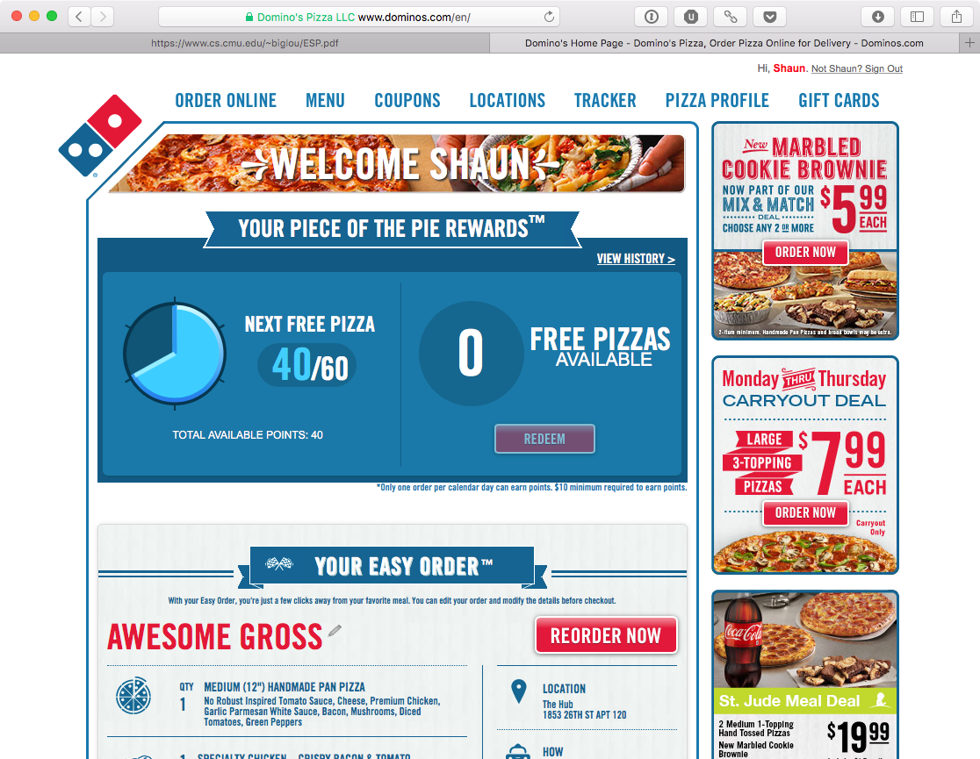
What is this trying to get the user to do?
Notes:
And be specific. If you go here, what are you planning? How can your choices be manipulated?

Slide 8
What do we know about this?
They want the user to buy more pizza
They understand the opportunities (buying 1 pizza is good, buying multiple is better, buying drinks is great bc higher margins)
… and risks (make a salad at home instead)
Notes:
And be specific. If you go here, what are you planning? What

Slide 9
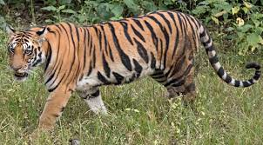
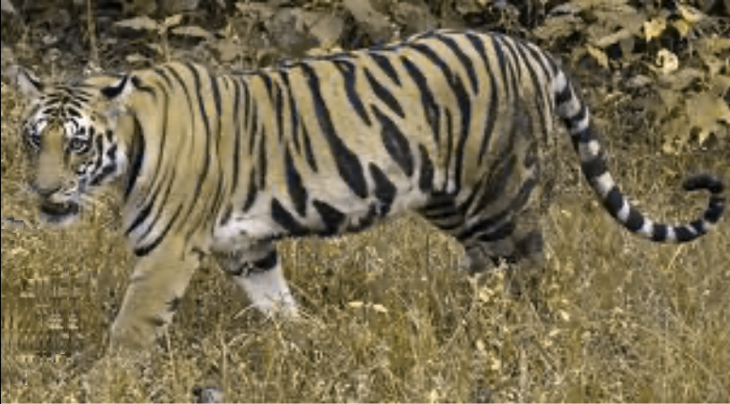
Studying optimal forms
Dominos’ motivation is simple
They spend $$$ to achieve it
If they knew a better way to do so, they would do that
So their approach is probably a good one
Notes:
Tiger image edited on https://www.color-blindness.com/coblis-color-blindness-simulator/
This is how tigers look to most mammals! (aka tiger food)
Tiger photo: https://en.wikipedia.org/wiki/Tiger
We can look at a tiger, an apex predator, and understand clearly why it has the features that it has – most relate directly to its role as a hunter

Slide 10
Starting point: cognitive biases
“People are not accustomed to thinking hard and are often content to trust a plausible judgment that quickly comes to mind.” –Daniel Kahneman, A Perspective on Judgment and Choice: Mapping Bounded Rationality

Slide 11
Cognitive biases
Daniel Kahneman, in Thinking Fast and Slow, says we have two cognitive systems
System 1: Fast, lazy, loves heurististics and approximations
System 2: Slow, deliberate, effortful
In other words, we can be reasonable, but it’s difficult
And we try to avoid the work of being reasonable (Fiske and Taylor’s cognitive miser theory)
Notes:
Thinking Fast and Slow: https://content.taylorfrancis.com/books/download?dac=C2018-0-82622-6&isbn=9781912453207&format=googlePreviewPdf
Good article summarizing these systems: https://tu-dresden.de/mn/psychologie/allgpsy/ressourcen/dateien/lehre/lehreveranstaltungen/Lehre-Kroenke-Seminar-KN/Kahneman_2003.pdf?lang=en

Slide 12
Some cognitive biases
Many different ones (but often have similar underlying structures)
Some notable biases:
Confirmation bias — the tendency to search for or interpret information in a way that confirms one's preconceptions.
Hyperbolic discounting — the tendency for people to have a stronger preference for more immediate payoffs relative to later payoffs, the closer to the present both payoffs are.
Extreme aversion — most people will go to great lengths to avoid extremes. People are more likely to choose an option if it is the intermediate choice.
Unit bias — the tendency to want to finish a given unit of a task or an item with strong effects on the consumption of food in particular
Impact bias — the tendency for people to overestimate the length or the intensity of the impact of future feeling states.
Notes:
https://rationalwiki.org/wiki/List_of_cognitive_biases

Slide 13
Probability biases
Primacy effect — the tendency to weigh initial events more than subsequent events.
Recency effect — the tendency to weigh recent events more than earlier events.
Availability heuristic — a biased prediction, due to the tendency to focus on the most salient and emotionally-charged outcome.
Clustering illusion — the tendency to see patterns where actually none exist.
Frequency illusion — the phenomenon in which people who just learn or notice something start seeing it everywhere. Also known as the Baader-Meinhof Phenomenon.
Gambler's fallacy — the tendency to assume that individual random events are influenced by previous random events. For example, "I've flipped heads with this coin five times consecutively, so the chance of tails coming out on the sixth flip is much greater than heads."
Overconfidence effect — the tendency to overestimate one's own abilities.

Slide 14
Effects of probability biases?
Making decisions with unclear payoff: should I vote? Exercise today? Apply to this job?

Slide 15
Social biases
Fundamental attribution error — the tendency for people to over-emphasize personality-based explanations for behaviors observed in others while under-emphasizing the role and power of situational influences on the same behavior.
Halo effect — the tendency for a person's positive or negative traits to "spill over" from one area of their personality to another in others' perceptions of them (see also physical attractiveness stereotype).
Ingroup bias — the tendency for people to give preferential treatment to others they perceive to be members of their own groups.
Projection bias — the tendency to unconsciously assume that others share the same or similar thoughts, beliefs, values, or positions.

Slide 16
Effects of social biases?
Most systems are social now, often what one person does is placed in context of what other people are doing
See also: voting behaviors, environmental sustainability, collective action, propagation of “fake news”

Slide 17
Comments on bias
When we talk about users formulating goals, making plans, making decisions, biases may be present
Even in unexpected cases – e.g. even solo apps may be influenced by social effects (“are you using the Fitbit app yet?”)
We often don’t know what those biases are (and users don’t either) – no simple list
These kinds of issues are often within our control, and thus we bear some responsibility for them (HCI is not just putting buttons on screen)

Slide 18
So what can we do?
Ultimately we need to pay attention to how and why people are using specific tools
We can also examine how existing systems are using persuasive techniques to achieve their goals
Especially when their goals are somewhat obvious

Slide 19
Levels of understanding
“Candy Crush wants to make money.”
“Here are the parts of Candy Crush that are optimized for making money.”
“This is why these parts of Candy Crush make money.”
“These techniques can be reused in my own designs (for other reasons).”
Notes:
Sometimes this seems like obvious stuff but it’s really not.

Slide 20
Approaches
Gamification – learning persuasive strategies from games (and game-like experiences)
Dark patterns – exploring how persuasive strategies can be misused

Slide 21
Gamification
Use of game elements in things not usually considered to be games
Leverage psychological effects of game design

Slide 22
Gamification: Discussion
Why are games persuasive?
Let’s come up with 5 examples

Slide 23
Gamification techniques
Framing of tasks as a challenge
Assigning points / progress bars
Setting goals
Awards/badges
Intermittent rewards
Story

Slide 24
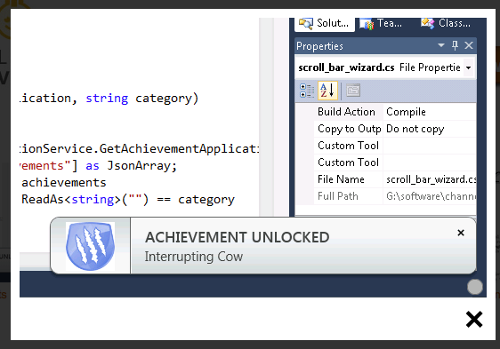
Visual Studio: achievement tracking
Notes:
https://channel9.msdn.com/achievements/visualstudio

Slide 25
Fitness trackers: progressive rewards, goal setting / achievement

Slide 26
Fitbit app: Social competition, leader bords

Slide 27
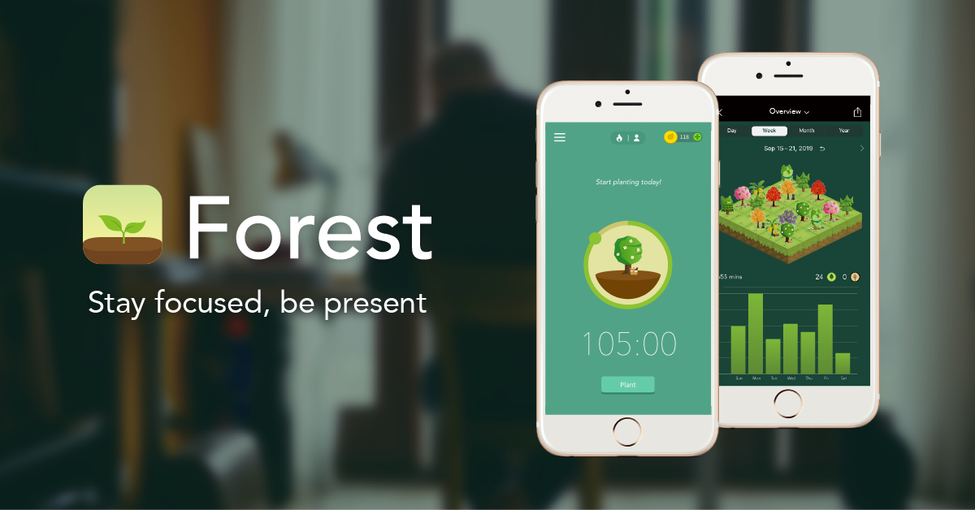
Forest: progressive reward, collection of previous achoevements
Notes:
http://www.forestapp.cc

Slide 28

Zombies Run: narrative progression

Slide 29
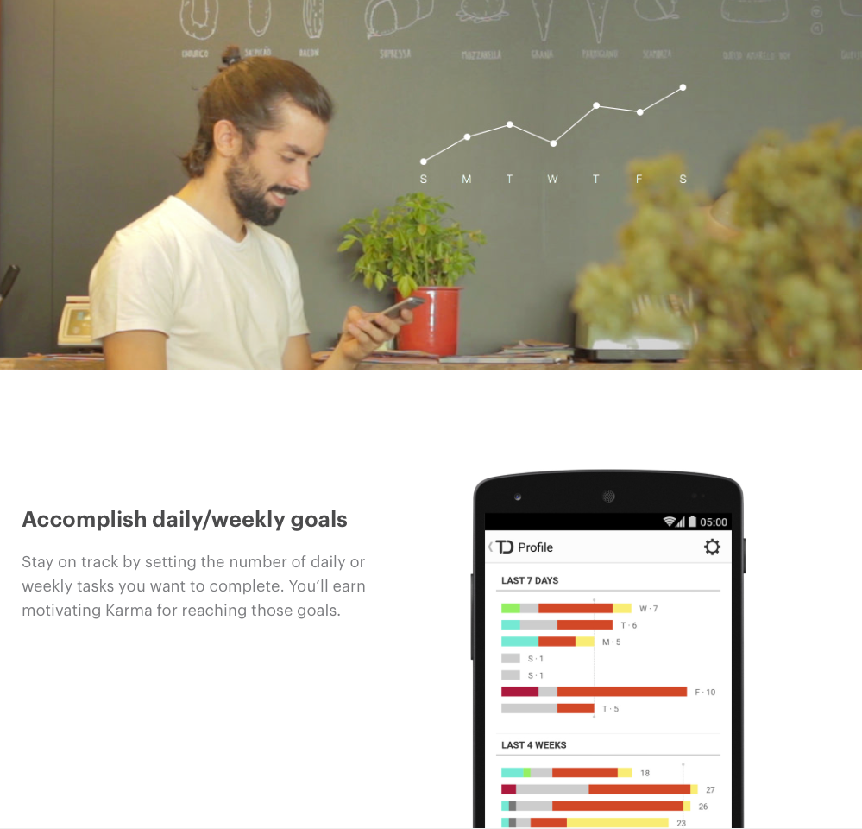
Todoist: Goal / streak tracking
Notes:
https://todoist.com/karma

Slide 30
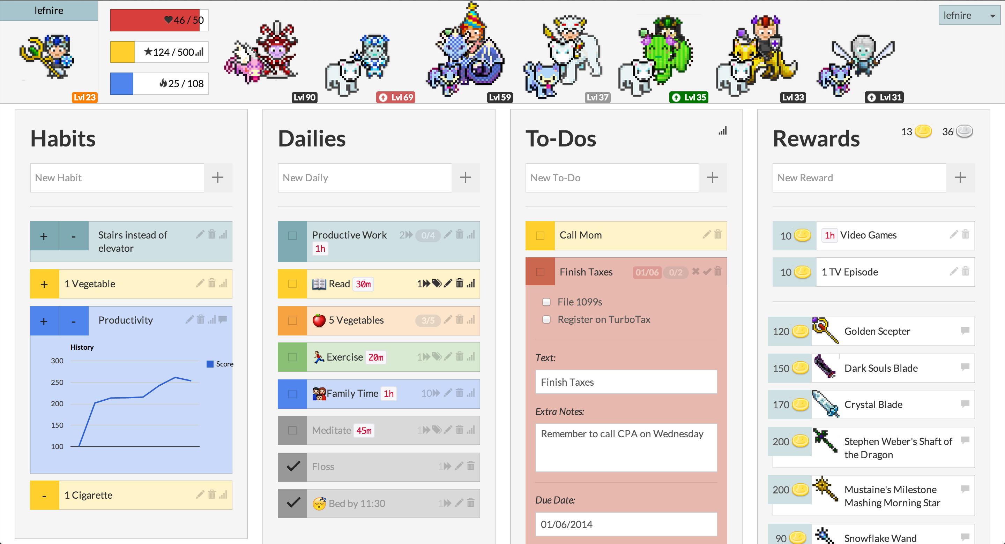
Habitica/HabitRPG
Notes:
http://habitica.com

Slide 31
Persuasive strategies outside the app
Supporting an existing plan vs. trying to change a plan
Notes:
Note the time

Slide 32
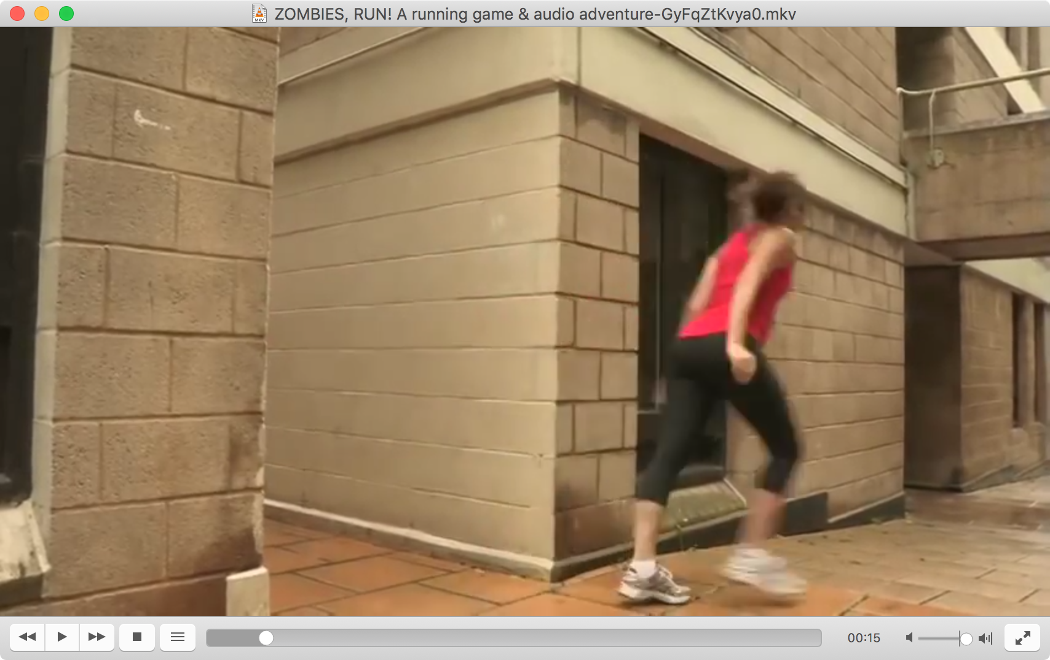
Gamification examples
Documenting progress
Achievements
Setting/tracking goals
Progressive narrative
Showing next goal
Social competition

Slide 33
Games with a purpose

Slide 34
Related: Games with a purpose
Designing game-like activities that, in doing them, something useful is done
Often involves making something competitive

Slide 35
reCAPTCHA

Slide 36
The ESP Game

Slide 37
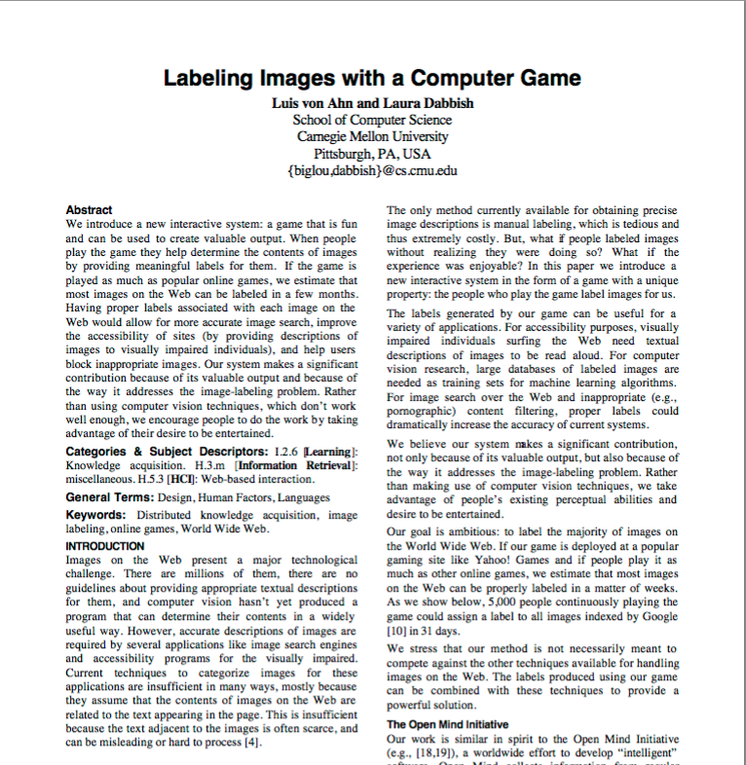
The ESP Game

Slide 38
Other resources
Gamification techniques: https://en.wikipedia.org/wiki/Gamification
Stanford persuasive technology lab: http://captology.stanford.edu
Notes:
There used to be a cool gamification wiki but it seems to have gone away.

Slide 39
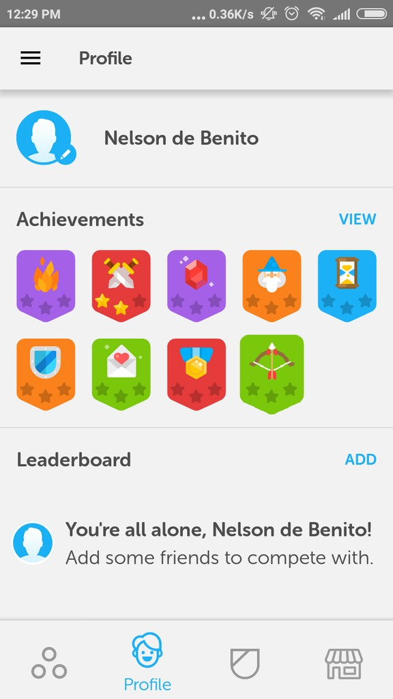
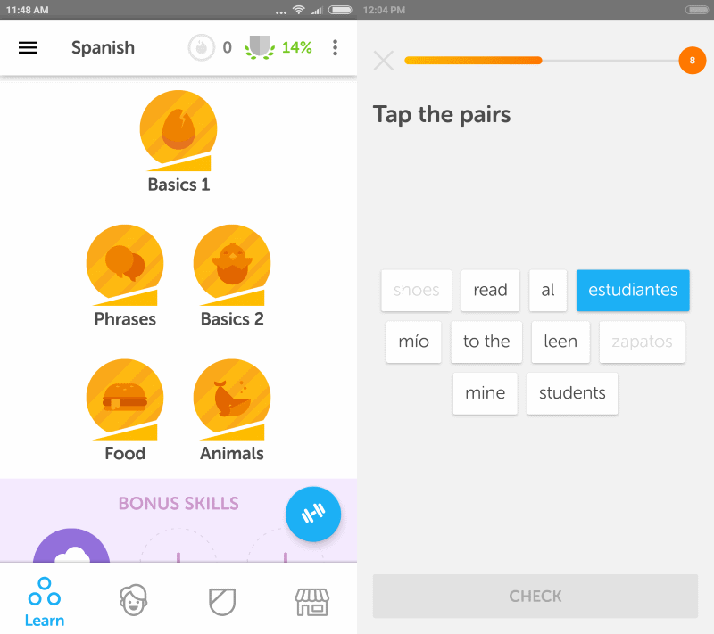
reCAPTCHA and Duolingo
Notes:
From the same team

Slide 40
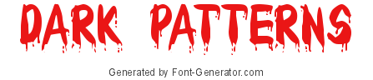

Slide 41
How to be evil
How can we use what we know about good design practices to misdirect or influence users?
We call these
(following from Christopher Alexander’s design patterns)
Notes:
https://www.font-generator.com/fonts/Bloody/
What makes it “dark”?
One aspect is being deceptive
Another is more clearly prioritizing designer’s goals over user goals

Slide 42
Design patterns
Originally from architecture
Describes an arrangement of elements that structures action in a deliberate way
Example: Different tables in this classroom
Notes:
Architecture example:

Slide 43
Design patterns in HCI
Problem-oriented UI configurations
Example: “Wizard”
Problem: Users don’t know what choices they have to make, or in which order
Solution: Create a sequence of choices that the user can walk through
Notes:
https://uxplanet.org/wizard-design-pattern-8c86e14f2a38
Note that the implementation of this could be very different! You can imagine this as a purely voice UI, for example. The design pattern describes the structure of the solution (ordered pages with one choice each) but not the specific implementation.

Slide 44
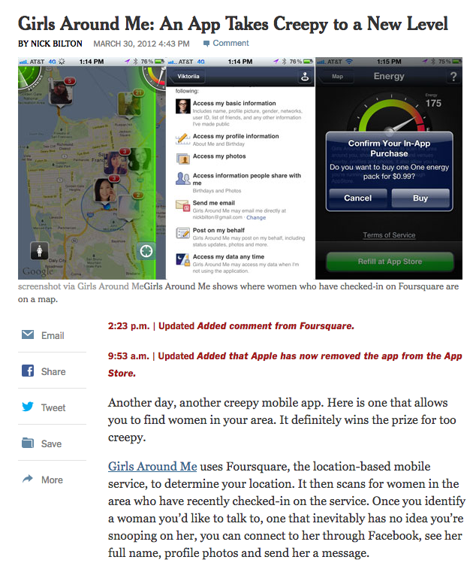
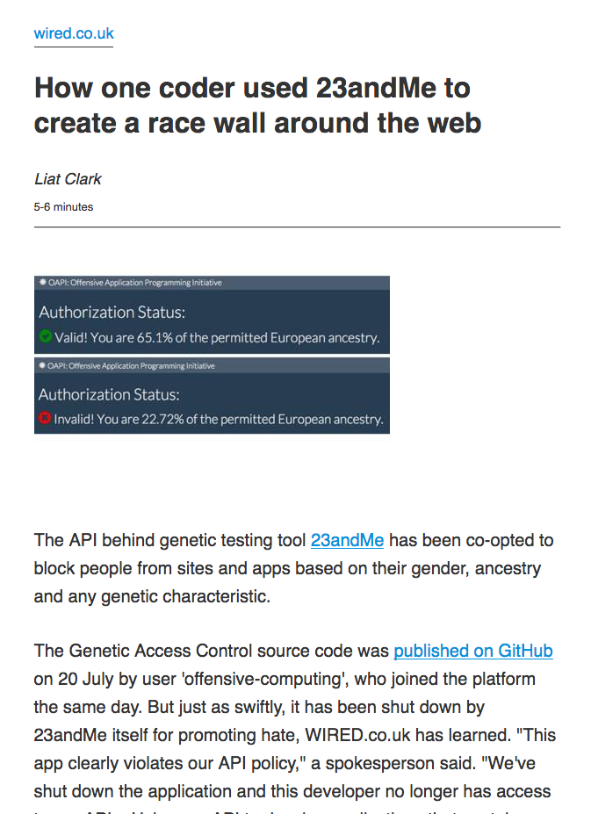
Design noir
Notes:
Consider dark aspects of design
We can do this as a design exercise – but this example is actually real

Slide 45
How dark patterns work
Rather than supporting a user in achieving their own goals, guide the user to a specific goal
While maintaining the illusion of choice
Draw the user’s attention to a particular choice
Miscommunicate the outcome
Often misuse good usability practices
Notes:
https://twitter.com/chillfinn/status/872389496737861633/photo/1

Slide 46
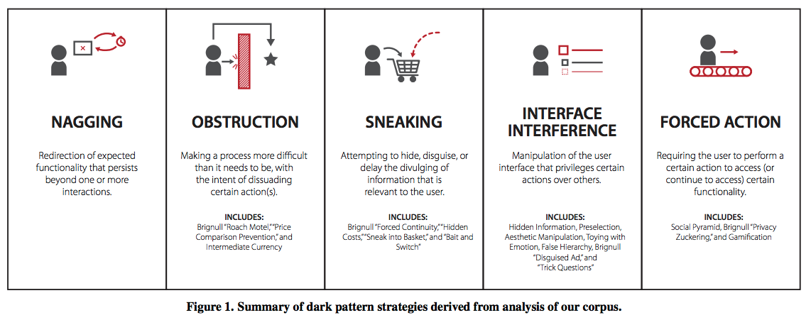
Dark pattern categories

Slide 47
Misdirecting user attention
Notes:
Both of these break the same rule about expecting what a button will do, and following line of sight.
Left: https://twitter.com/chillfinn/status/872389496737861633/photo/1
Right: https://twitter.com/kristinalustig/status/874986152012505088/photo/1

Slide 48
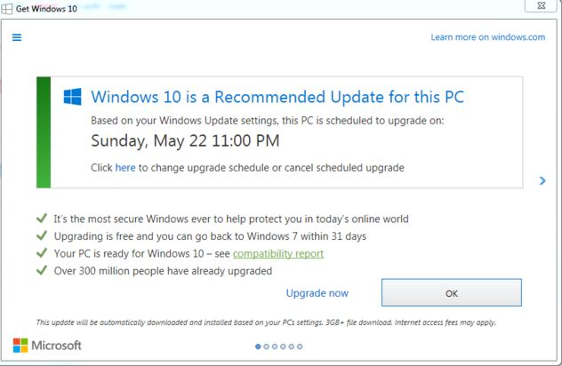
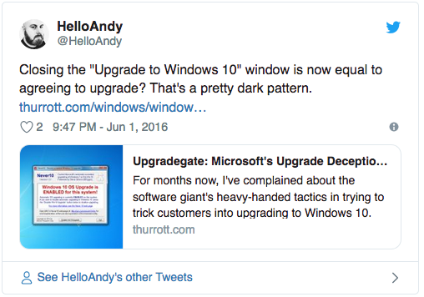
Bait and switch
Notes:
In this case, both options will cause the update to happen.

Slide 49
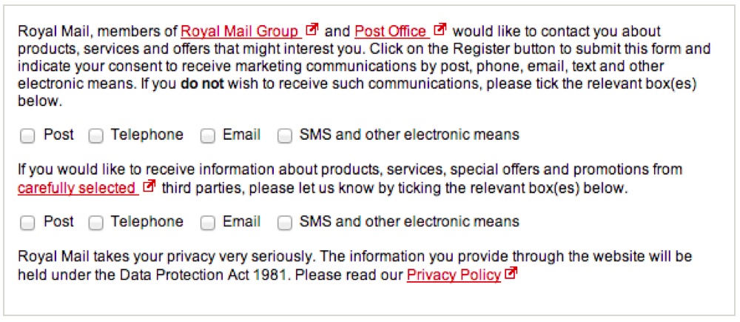
Trick questions
Question appears to be asking one thing, but it’s asking something else
Notes:
In this case, the first Q is opt-out and the second is opt-in

Slide 50
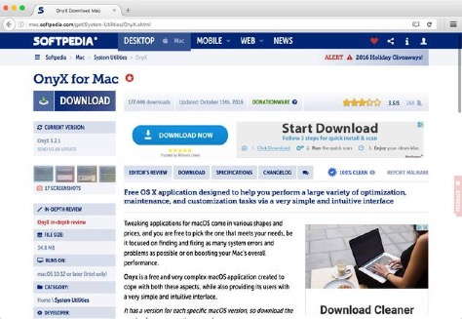
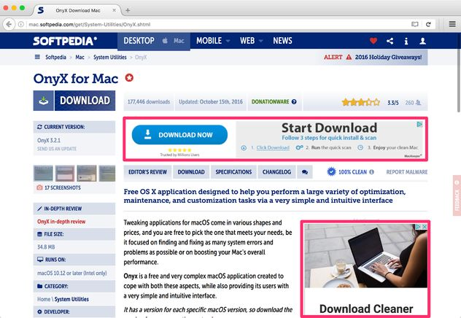
Disguised ads (and other bad stuff)
Notes:
This example always reminds me of biomimicry – ads have evolved to look like functional buttons.
https://darkpatterns.org/types-of-dark-pattern/disguised-ads

Slide 51

Confirm shaming
Make it difficult or unpleasant to confirm a difficult choice
Notes:
http://confirmshaming.tumblr.com/

Slide 52
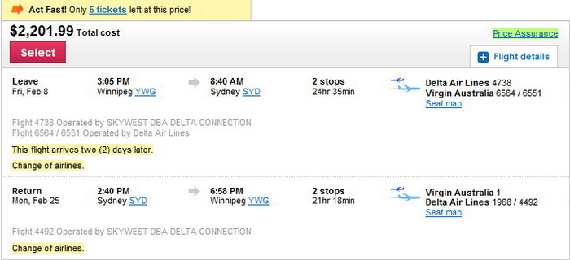
Perceived scarcity
Encourage a choice now, before it is too late
Notes:
http://www.cleanmpg.com/community/index.php?threads/44707/

Slide 53
How to make our own dark patterns
We can learn the basics of dark patterns by inverting our good patterns
Make important actions clear → make desired actions clear (and hide others)
Make system status visible → hide or mislead about system status
Recognition rather than recall → require users to perform complex steps to perform undesired actions
Notes:
We can invert Nielsen’s usability heuristics.

Slide 54
Summary
We can create dark patterns by doing the opposite of what good usability practices tell us
Likewise, we can sometimes learn useful tricks from dark patterns
It’s helpful to see examples where the designer’s intent is clear

Slide 55
Dark patterns activity
Pair up with 1 or 2 people
Build a quick prototype and include 3 examples of persuasion, dark patterns, or gamification
Choose an app; choose a perspective; add design features to persuade the user

